Slide 1
MUMBAI:
105, M.I. ESTATE, OFF. DR. E. MOSES ROAD, GANDHINAGAR, WORLI, MUMBAI - 400 018
PALGHAR:
54, KINGSTONE TOWER, KAUL'S HERITAGE CITY, VASAI (W), PALGHAR - 401201
NAVI MUMBAI:
OMKAR BRAMHA, SURVEY NO. 143/1, 144/3, 144/4, ADAI, PANVEL, DIST. RAIGAD, NAVI MUMBAI 410206
www.condesign.co.in
PROJECT BY – CONDESIGN ENGINEERS PVT. LTD.
RCC DESIGN & CONSULTANT – PROF. S. S. MUJAWAR
Reg. No. 2021/PMC/TP/1518/2021
PROJECT MANAGEMENT CONSULTANT– SES BHARAT
SPECIALIST CONTRACTOR – STRUCTOLIFE INDIA LLP
engg.condesign@yahoo.in
structolife@gmail.com
info@sesbharat.in
022 6610 0369
+91 9820640331
+91 7208122478
+91 7218786111

Slide 2
MUMBAI:
105, M.I. ESTATE, OFF. DR. E. MOSES ROAD, GANDHINAGAR, WORLI, MUMBAI - 400 018
PALGHAR:
54, KINGSTONE TOWER, KAUL'S HERITAGE CITY, VASAI (W), PALGHAR - 401201
NAVI MUMBAI:
OMKAR BRAMHA, SURVEY NO. 143/1, 144/3, 144/4, ADAI, PANVEL, DIST. RAIGAD, NAVI MUMBAI 410206
www.condesign.co.in
REPAIRS, STRENGTHENING & INTERNAL WORKS
PROJECT – BHAGWAN MANSION, MARINE LINES
engg.condesign@yahoo.in
structolife@gmail.com
info@sesbharat.in
022 6610 0369
+91 9820640331
+91 7208122478
+91 7218786111

Slide 3
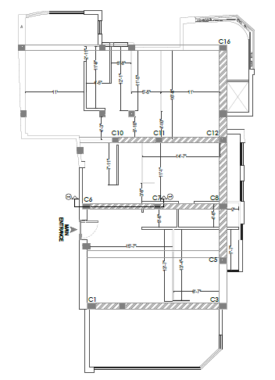
PROPOSED LAYOUT

Slide 4
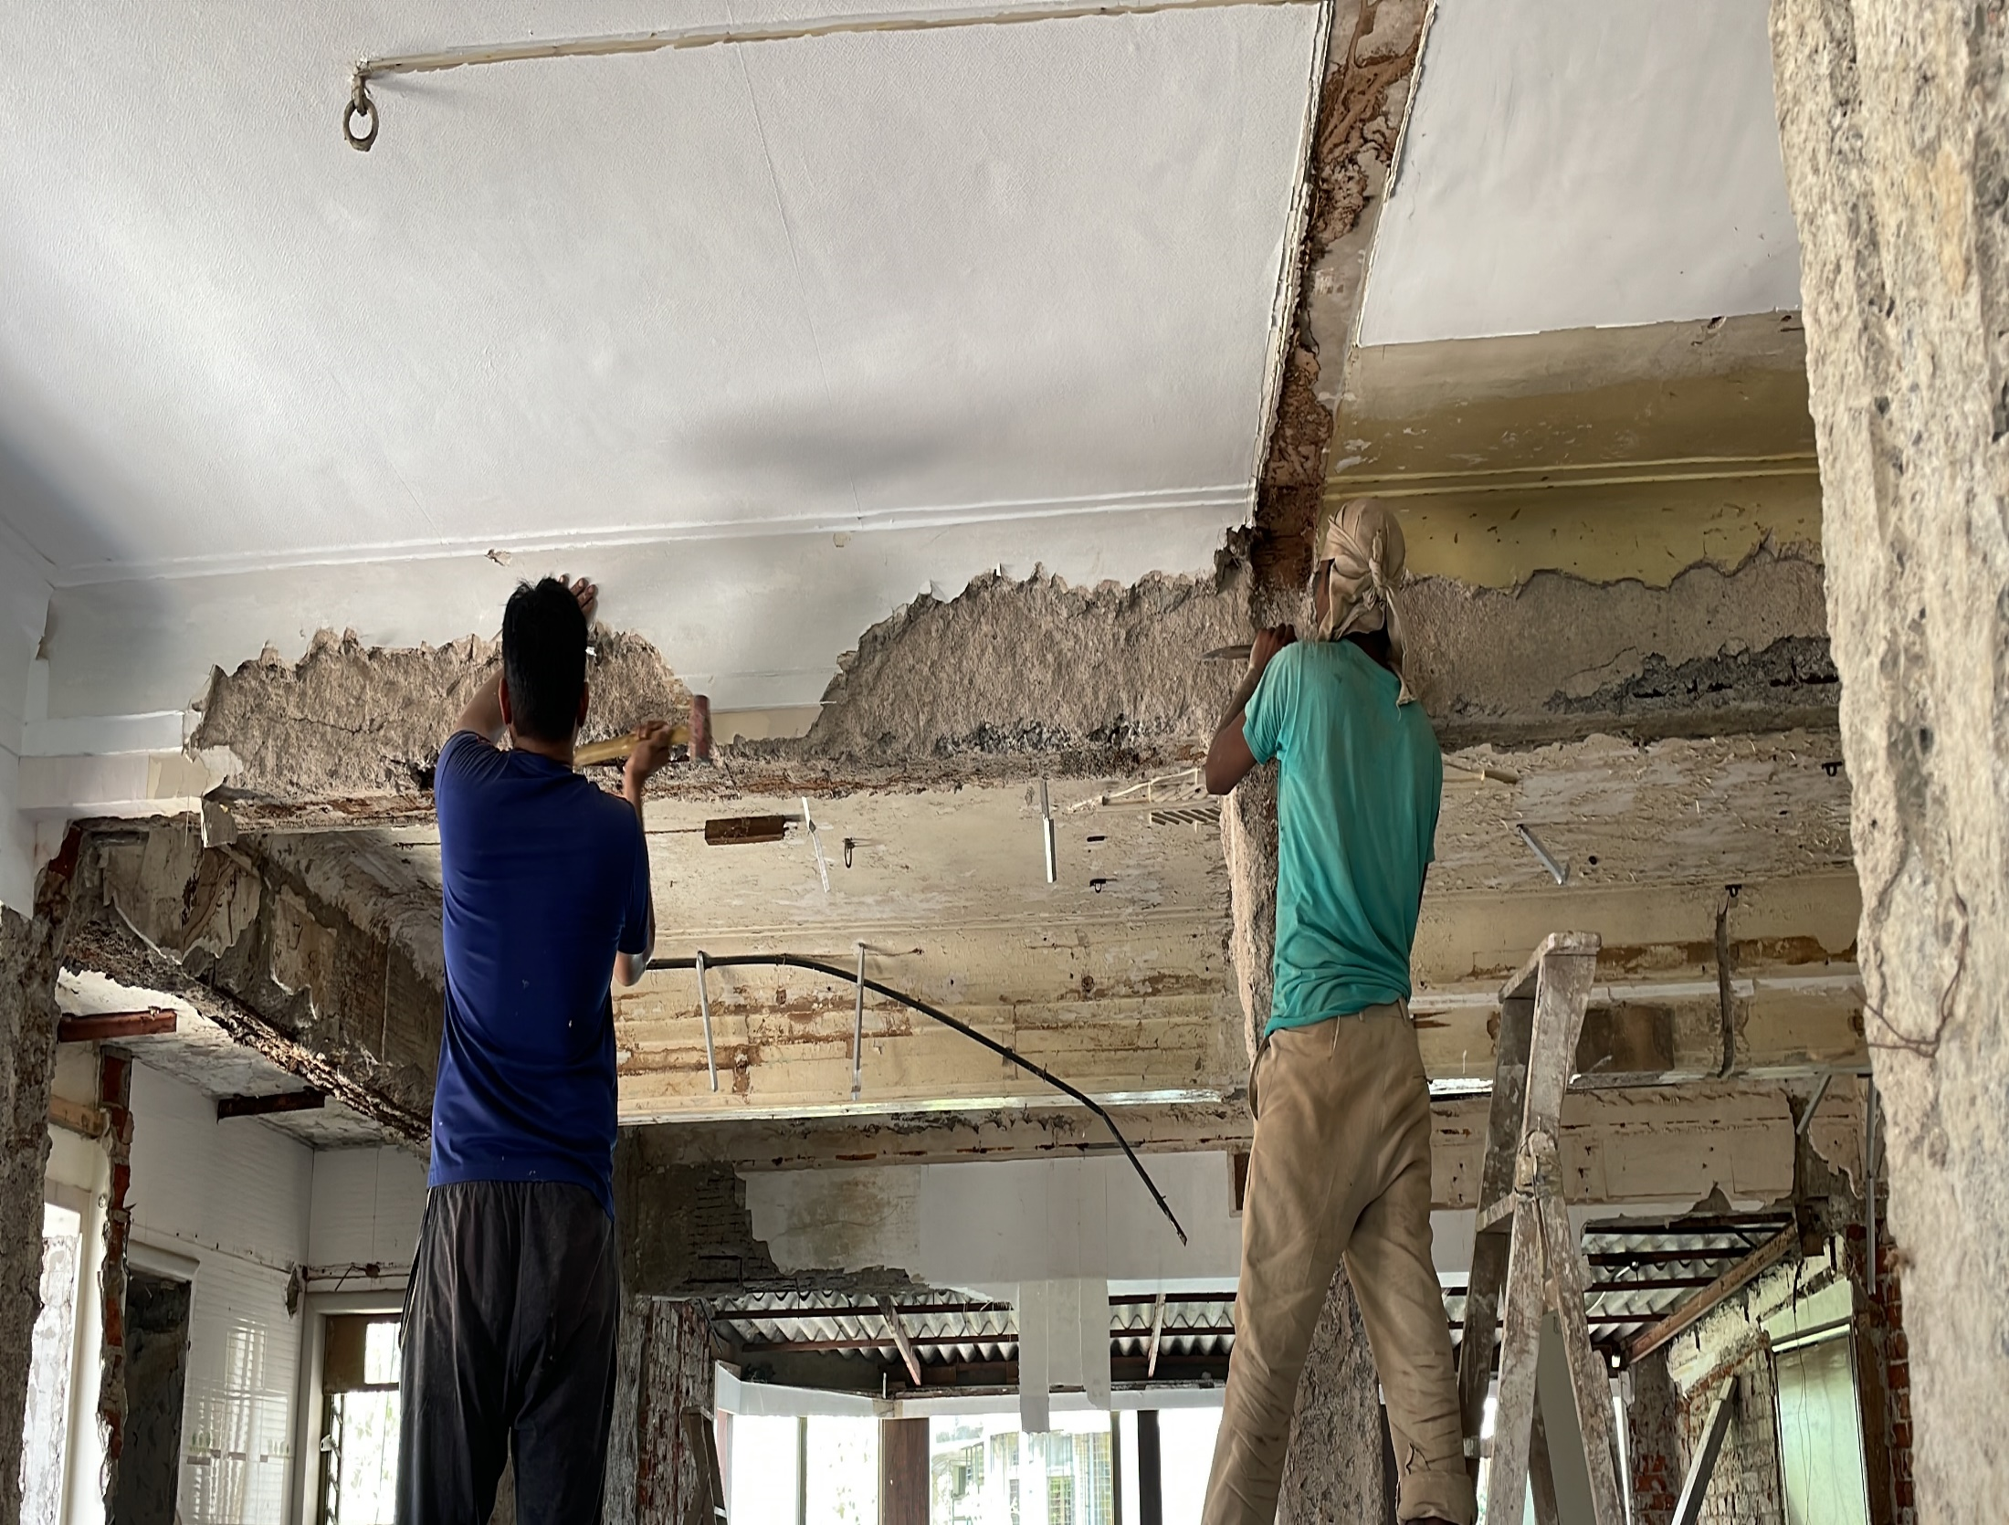
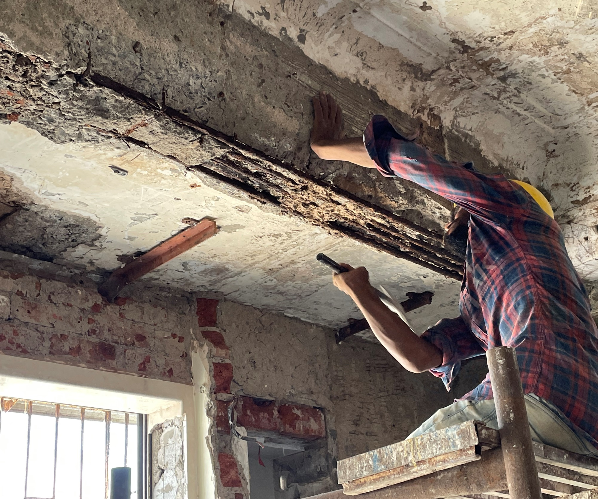
CHIPPING OF RCC MEMBER

Slide 5
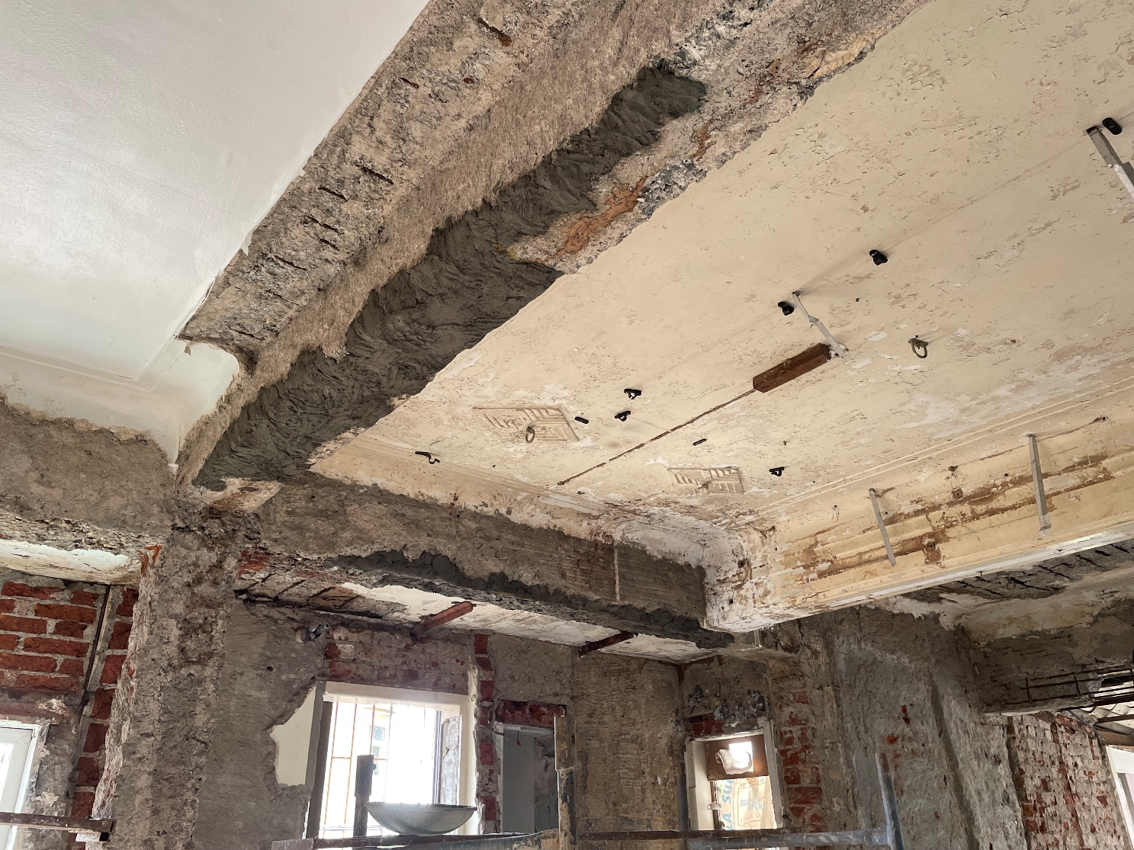
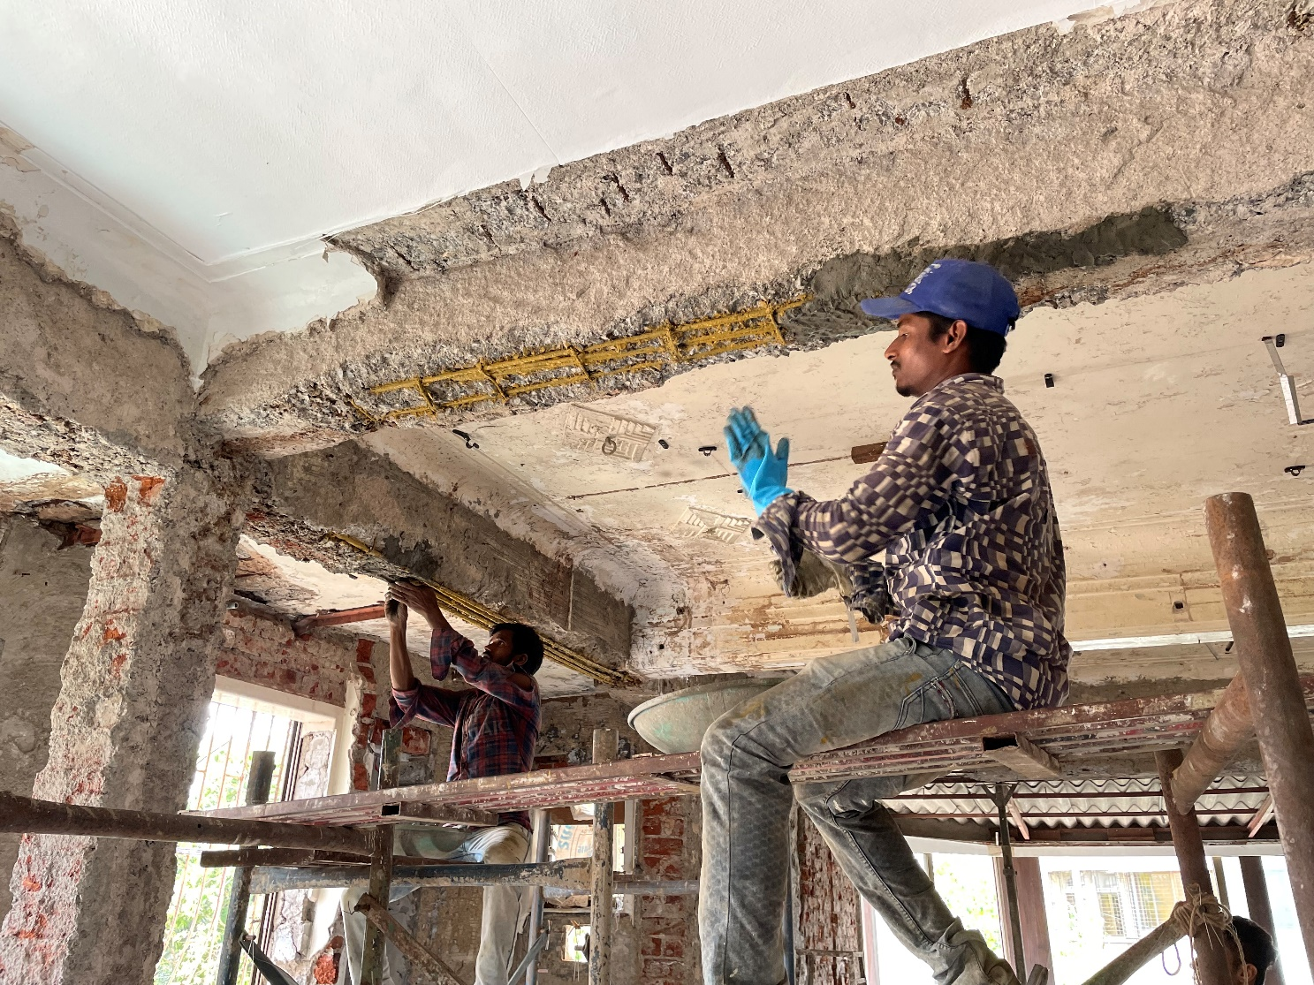
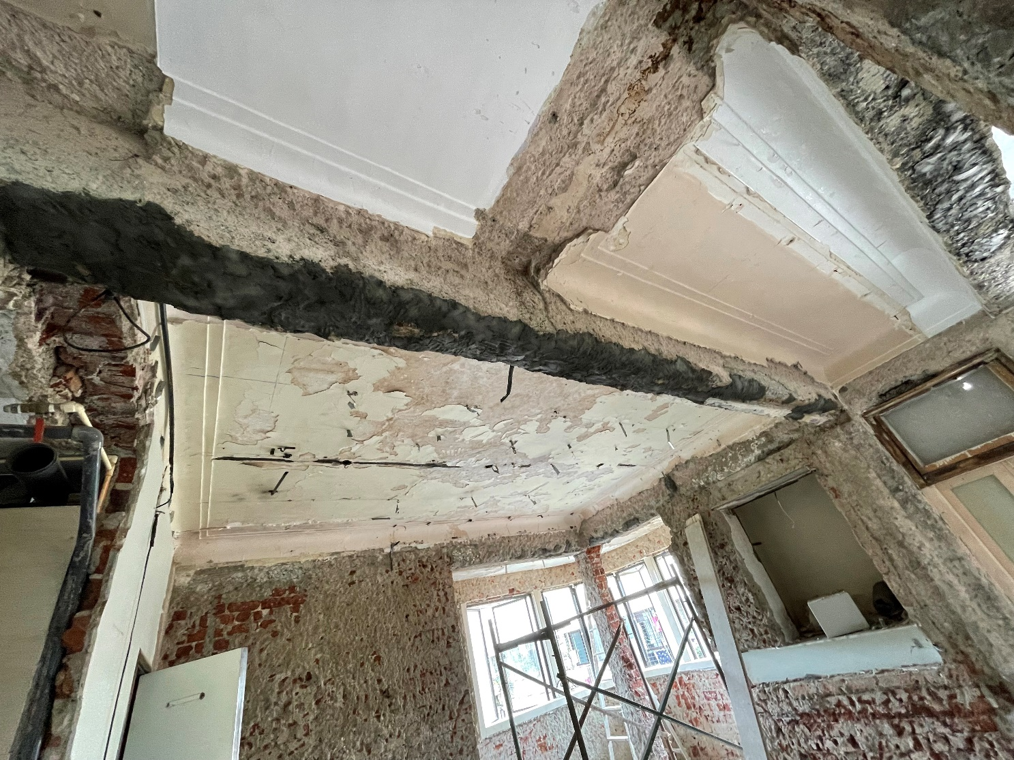
PMM TREATMENT

Slide 6
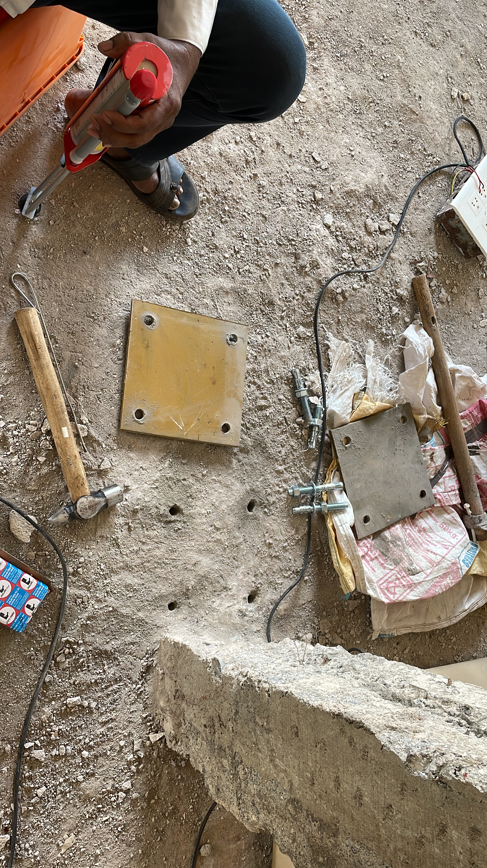
BASE PLATE FIXING AND CHEMICAL ANCHORING

Slide 7
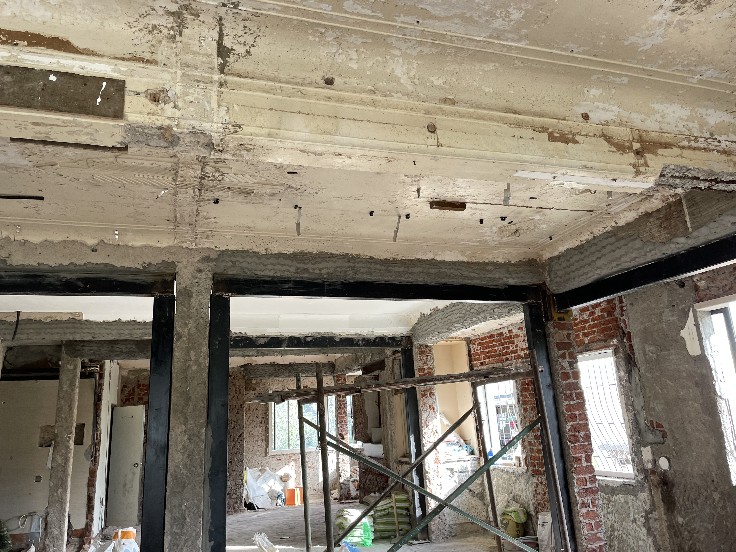
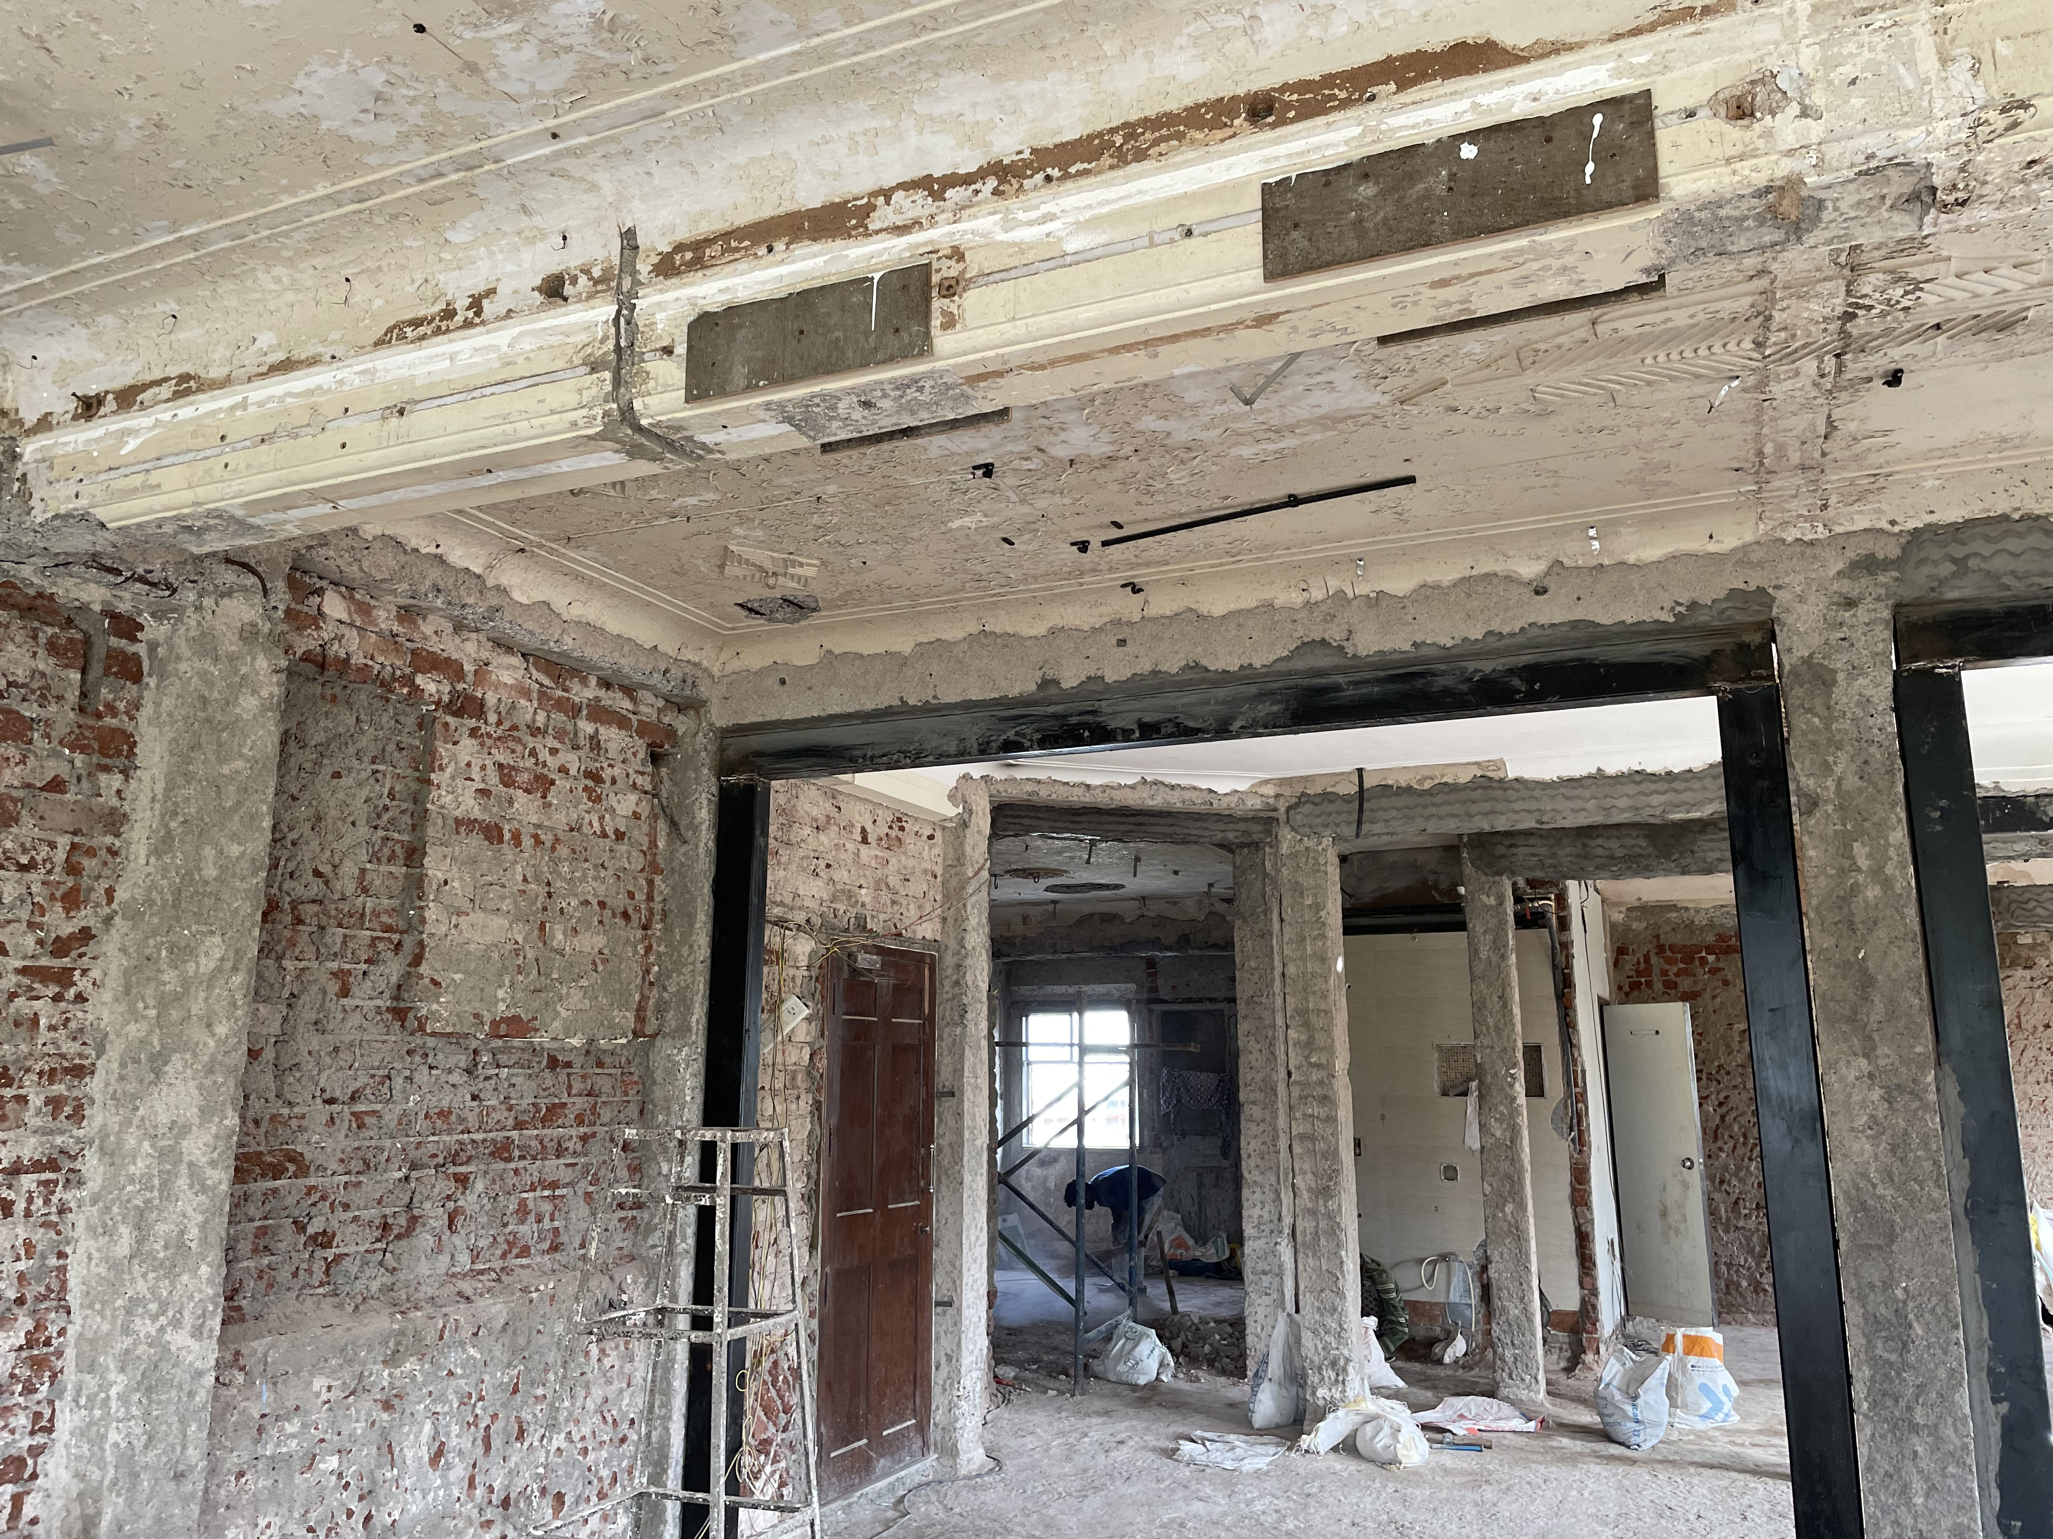
ERECTION OF MS ISHS

Slide 8
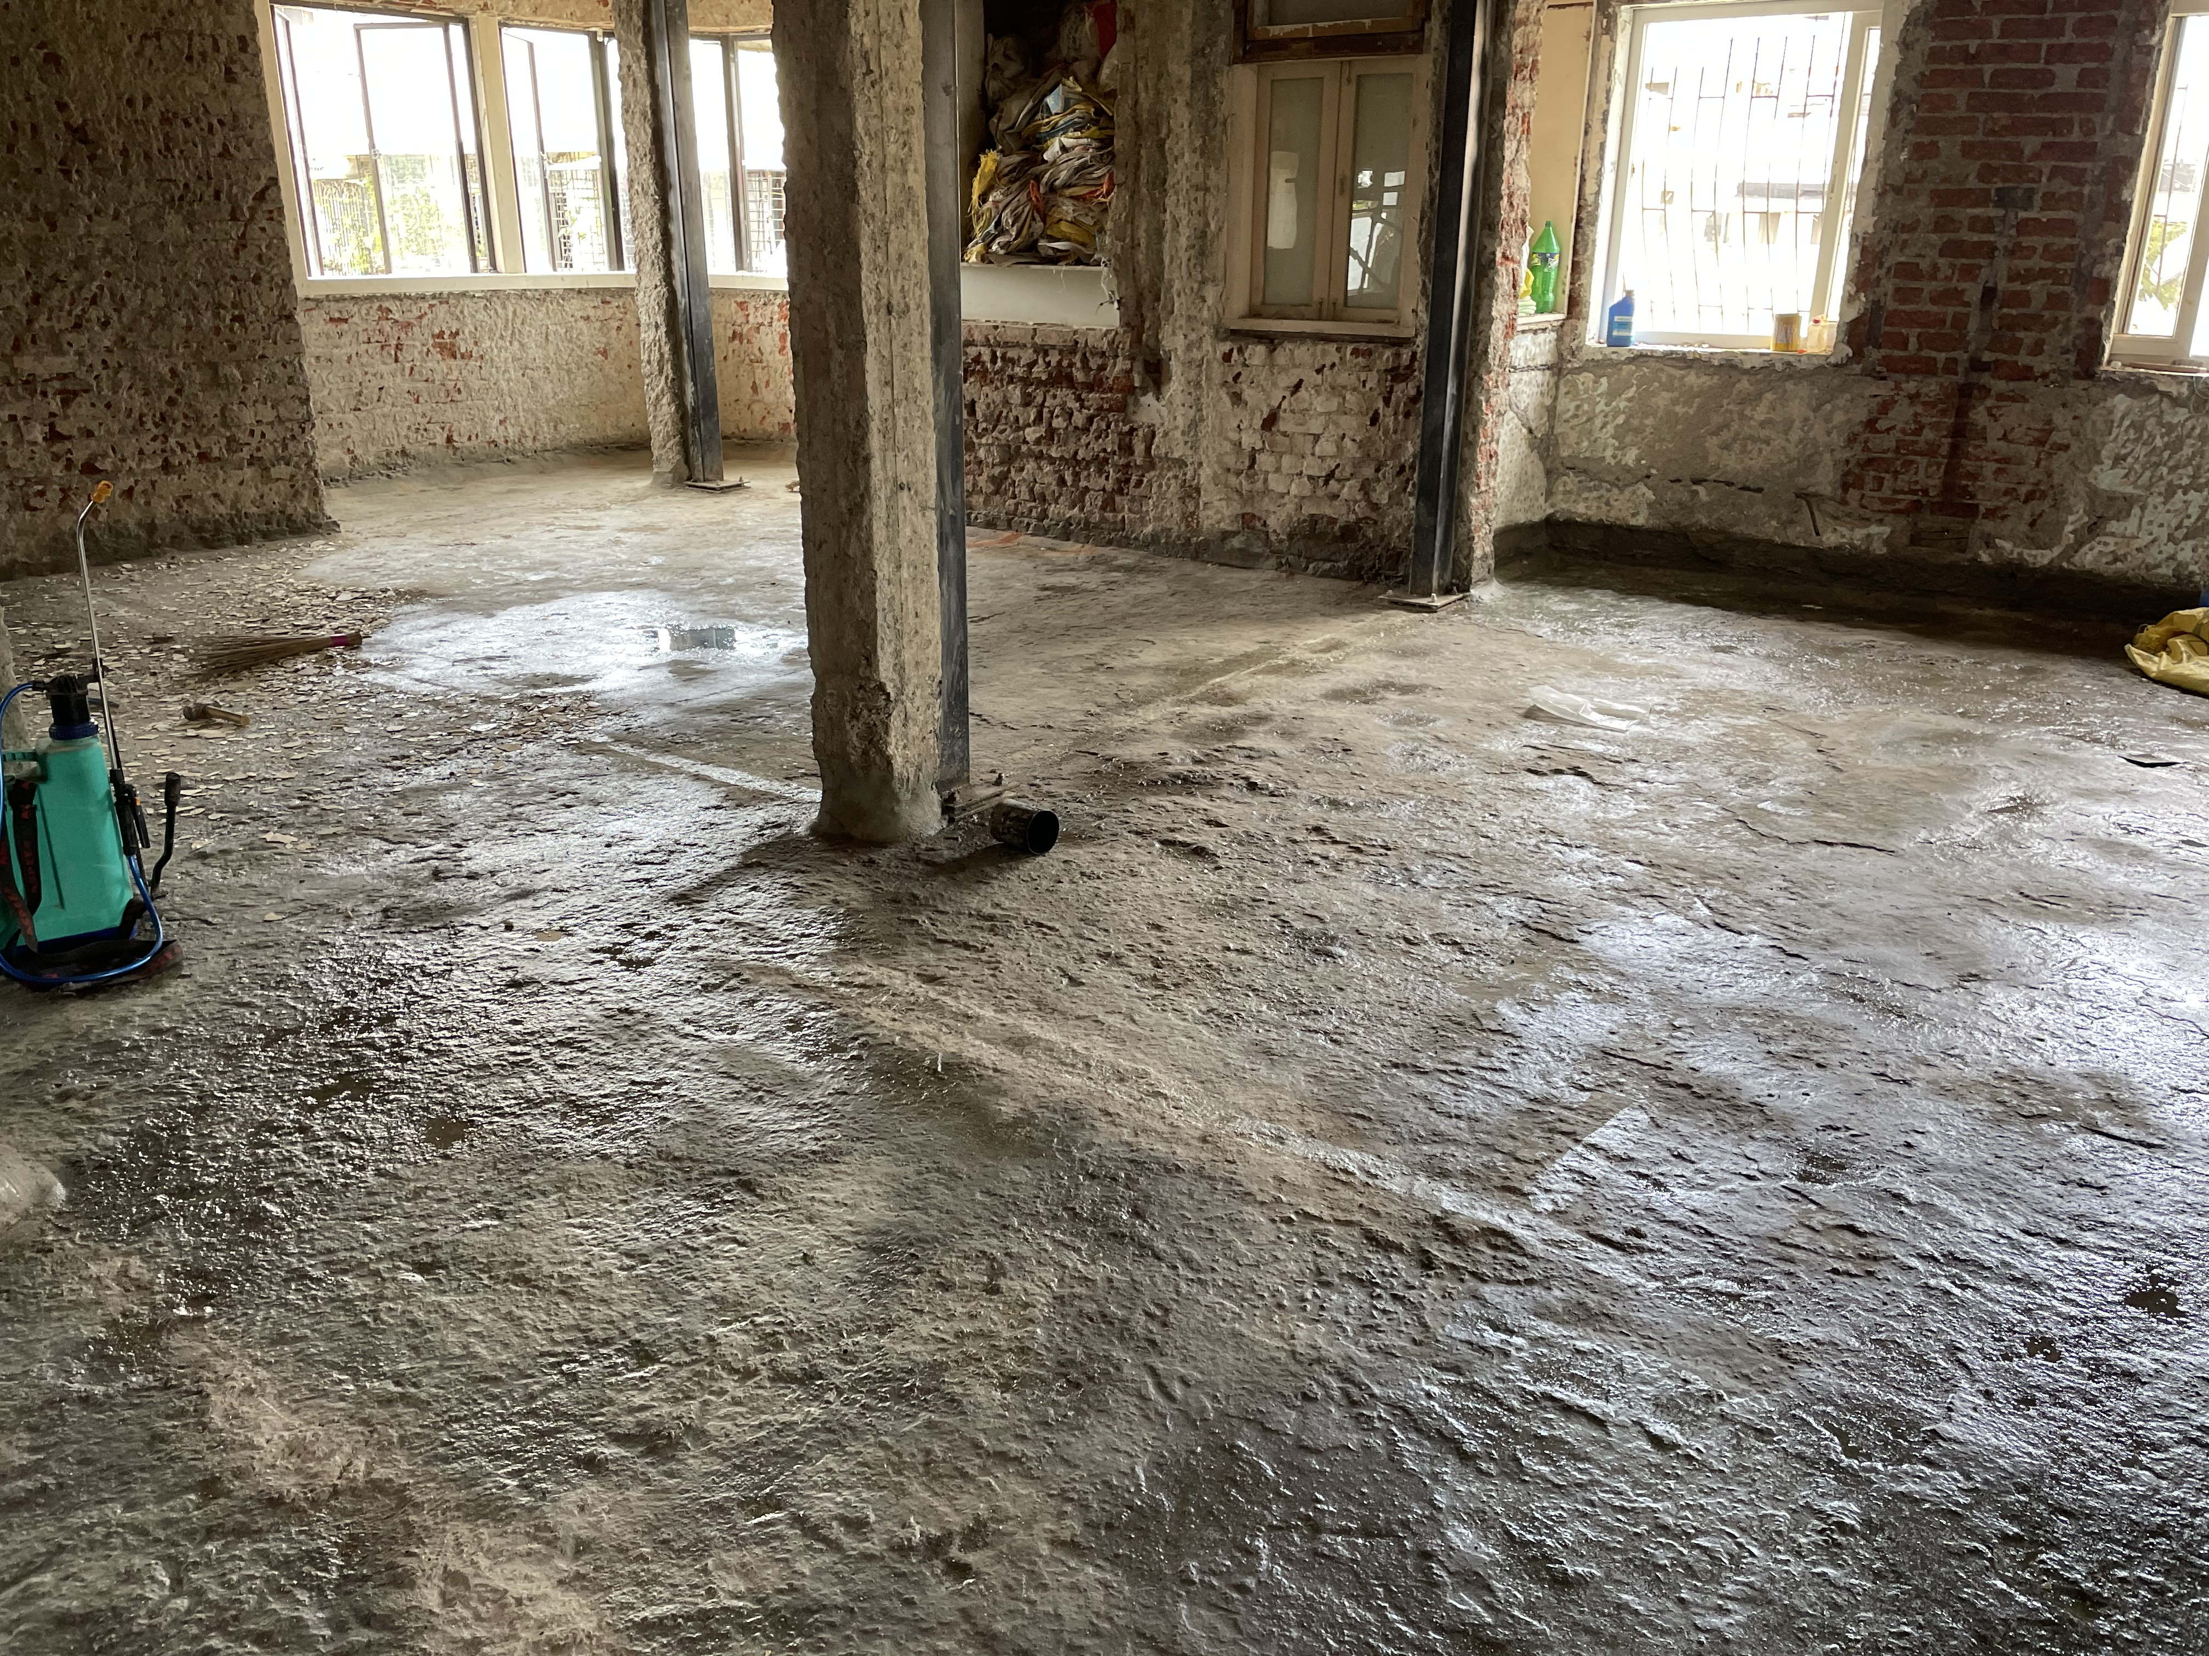
CHEMICAL WATERPROOFING ON FLOORS

Slide 9
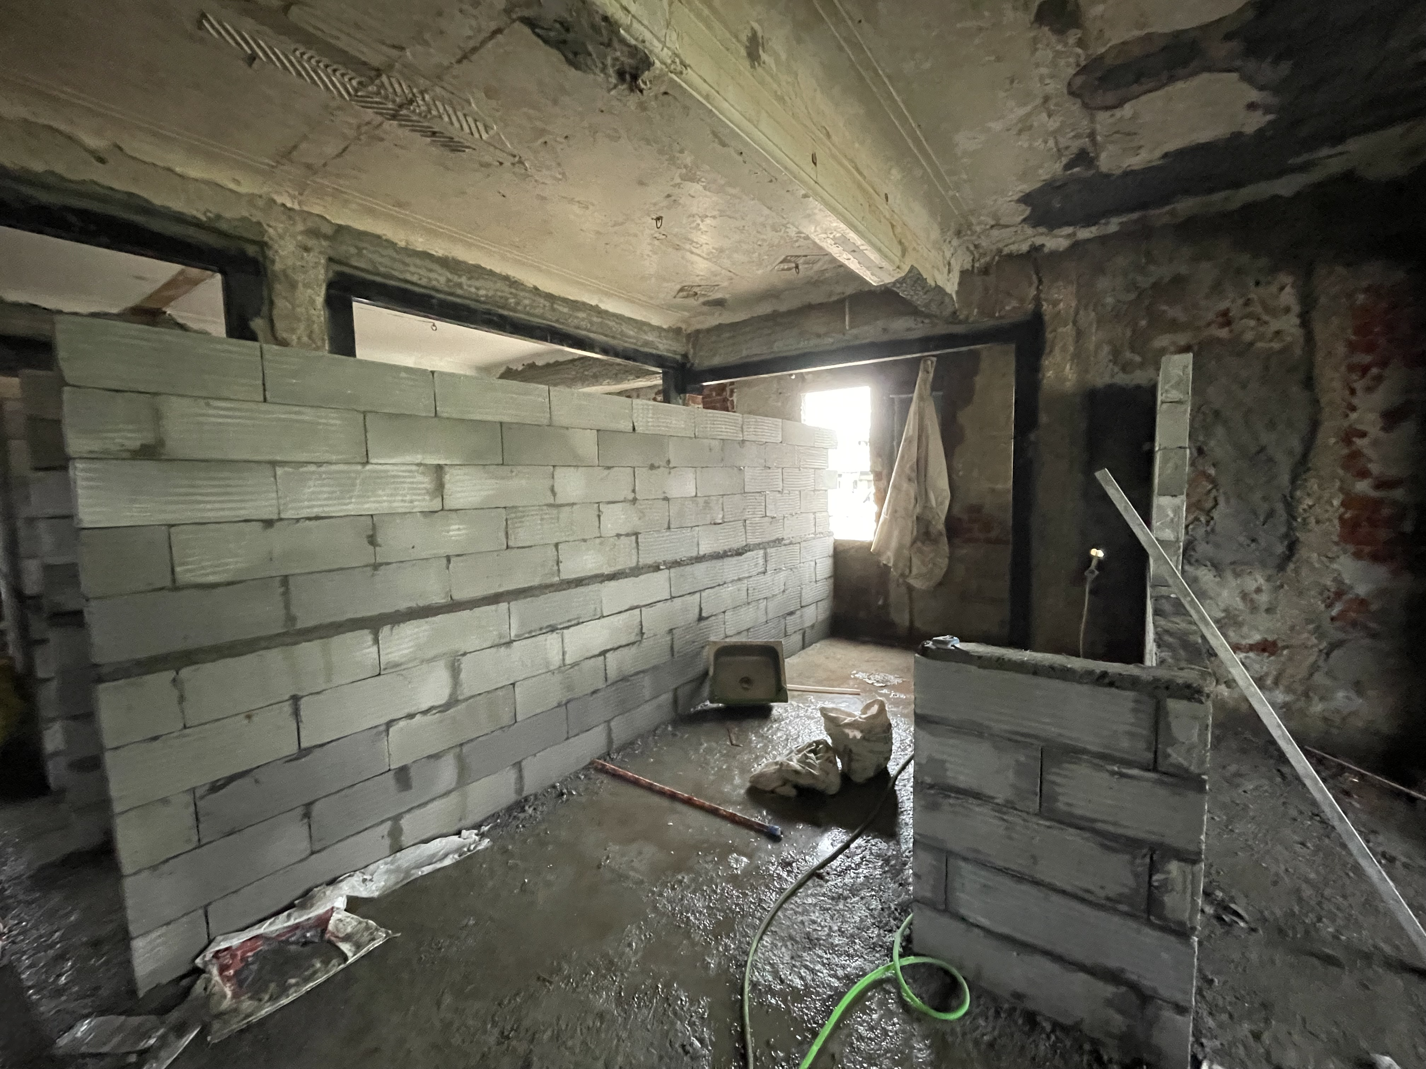
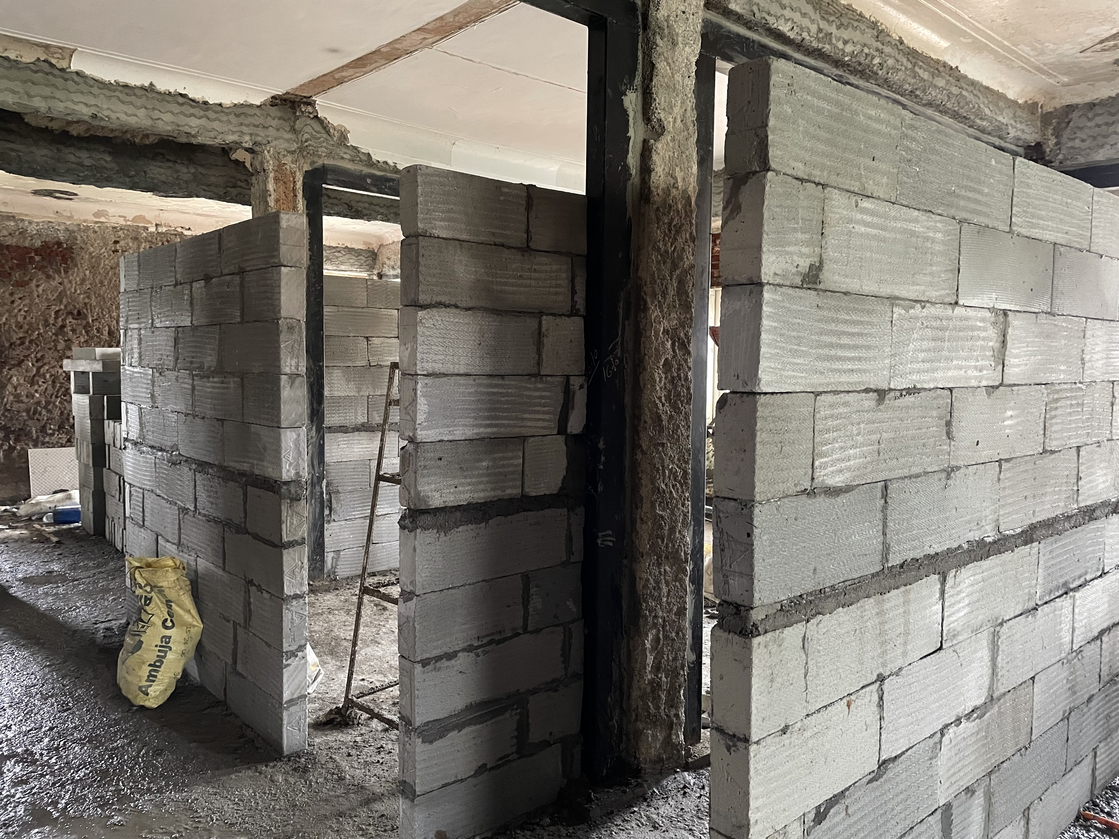
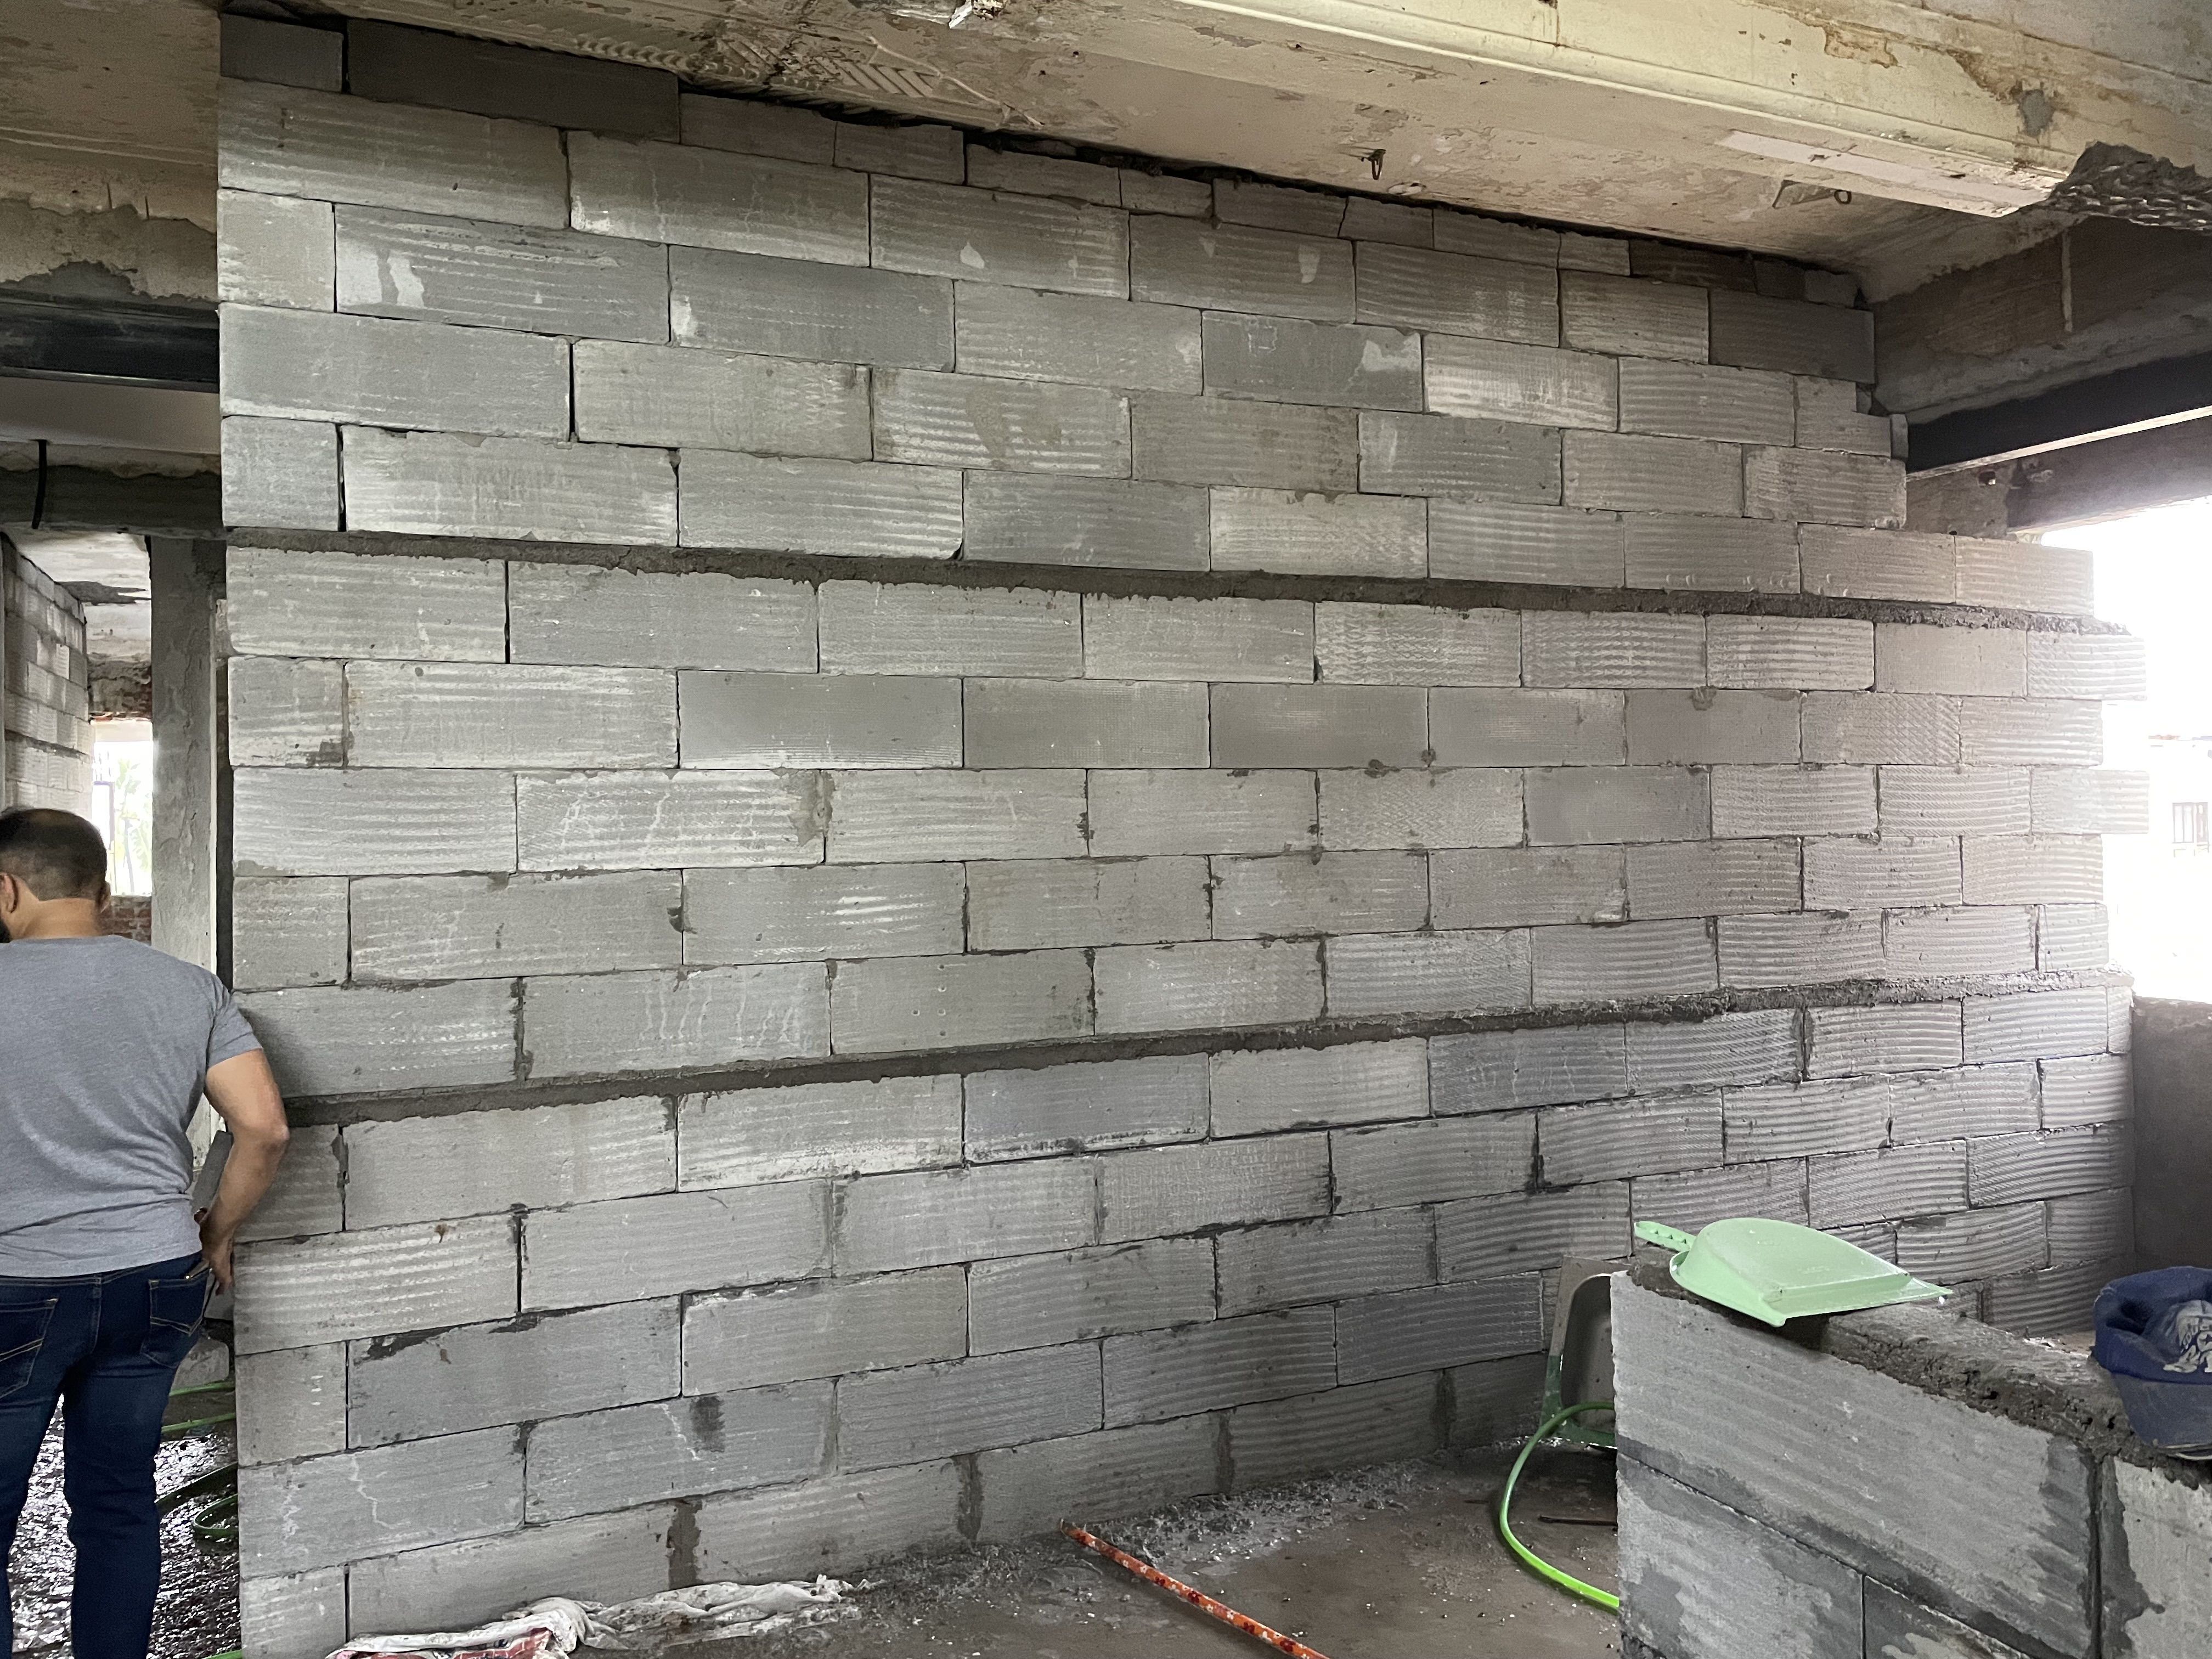
BLOCK WORK

Slide 10
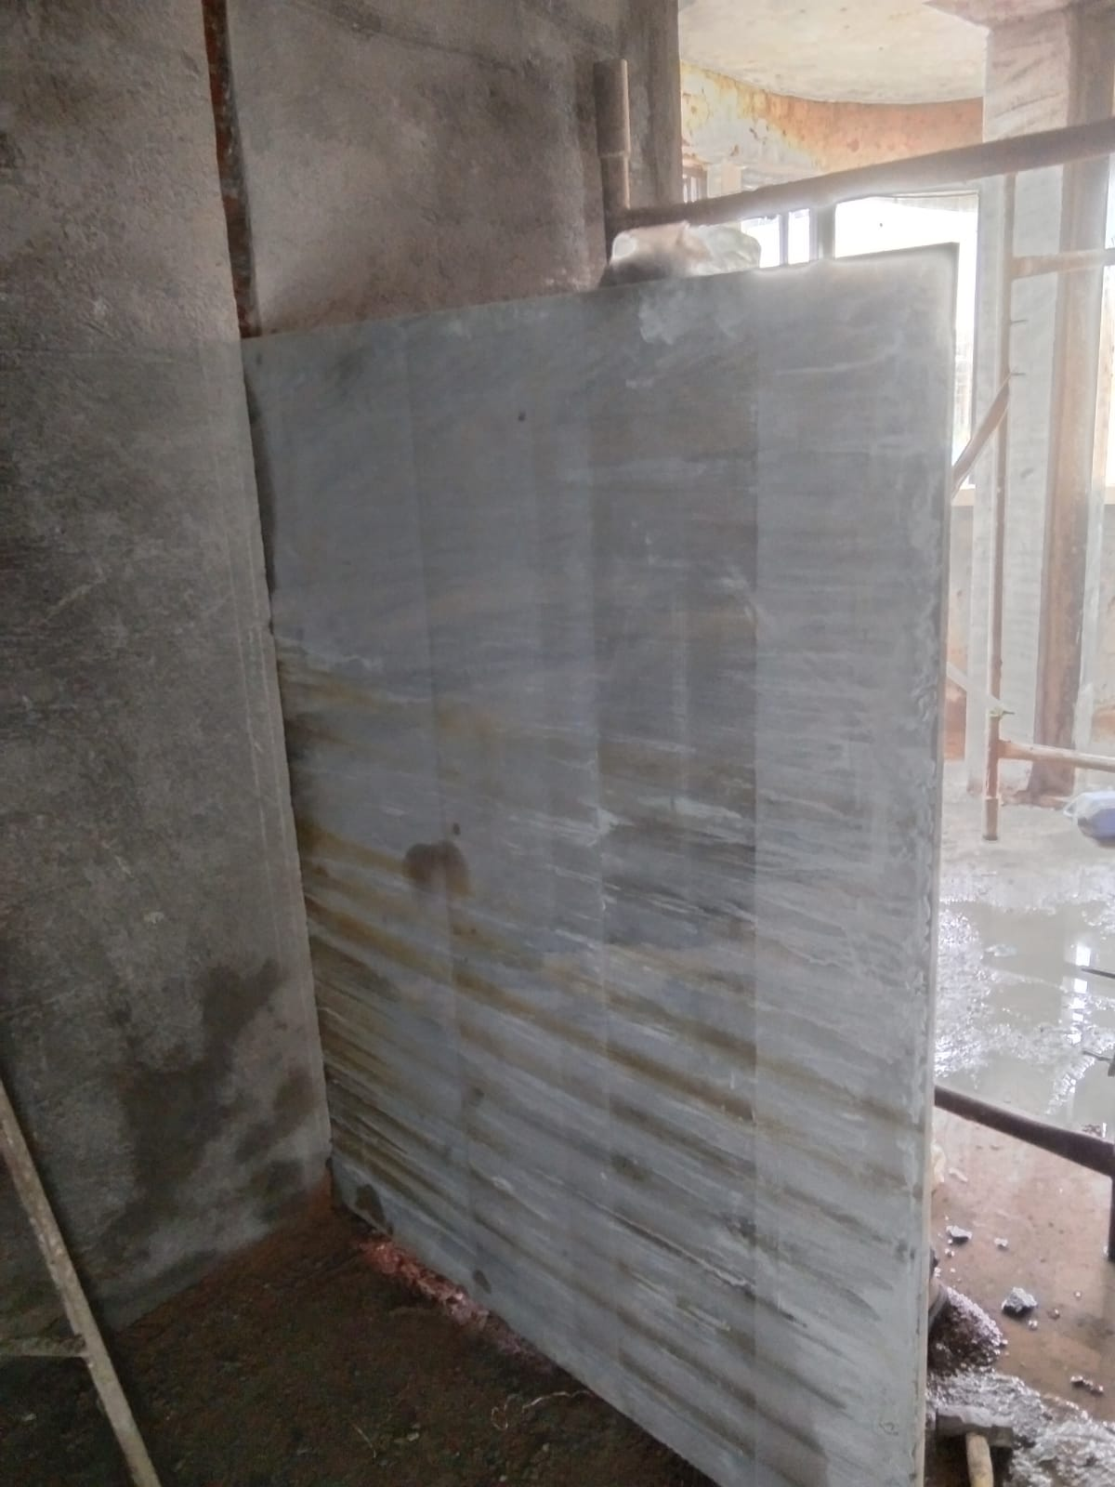
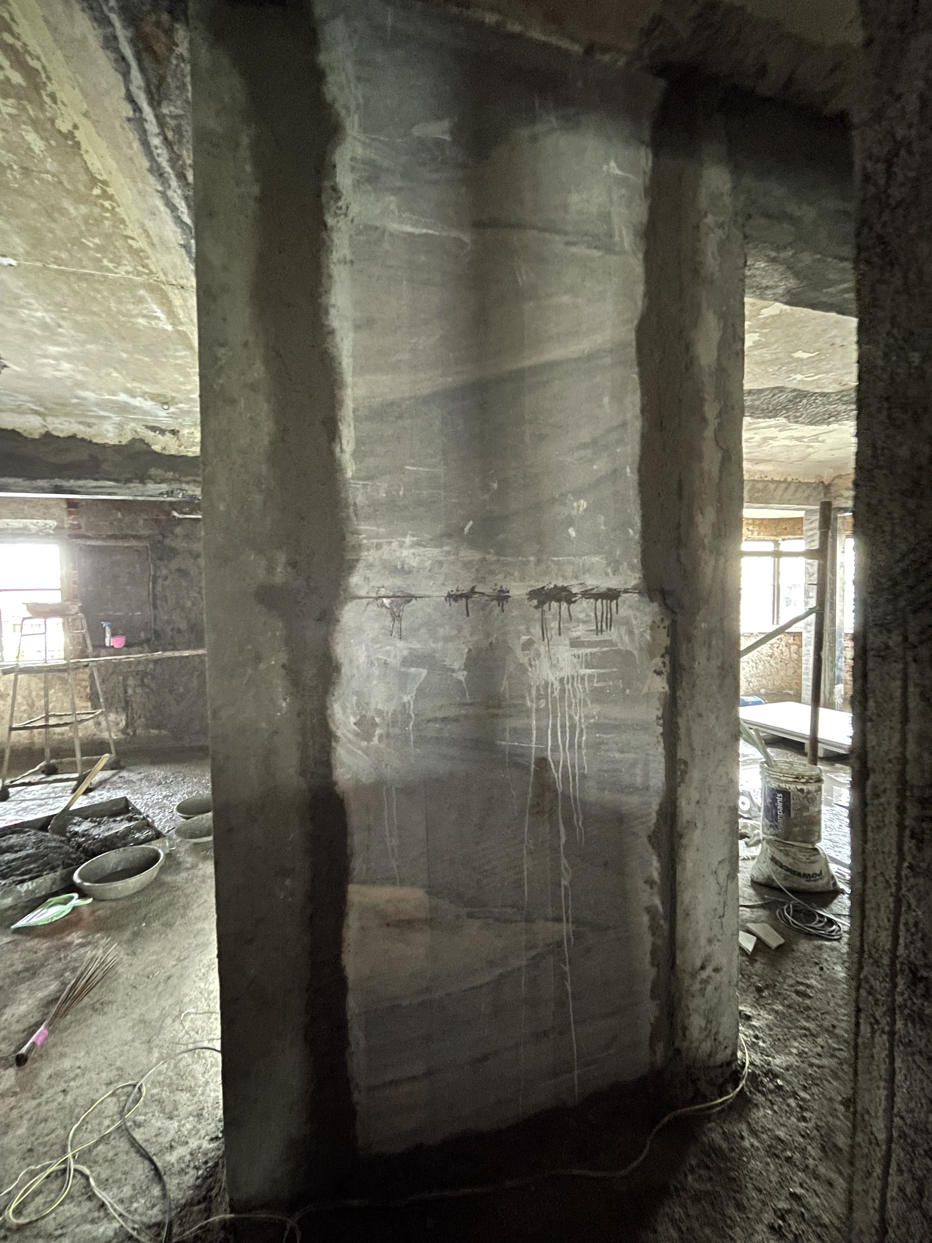
MARBLE PARTITION WORK

Slide 11
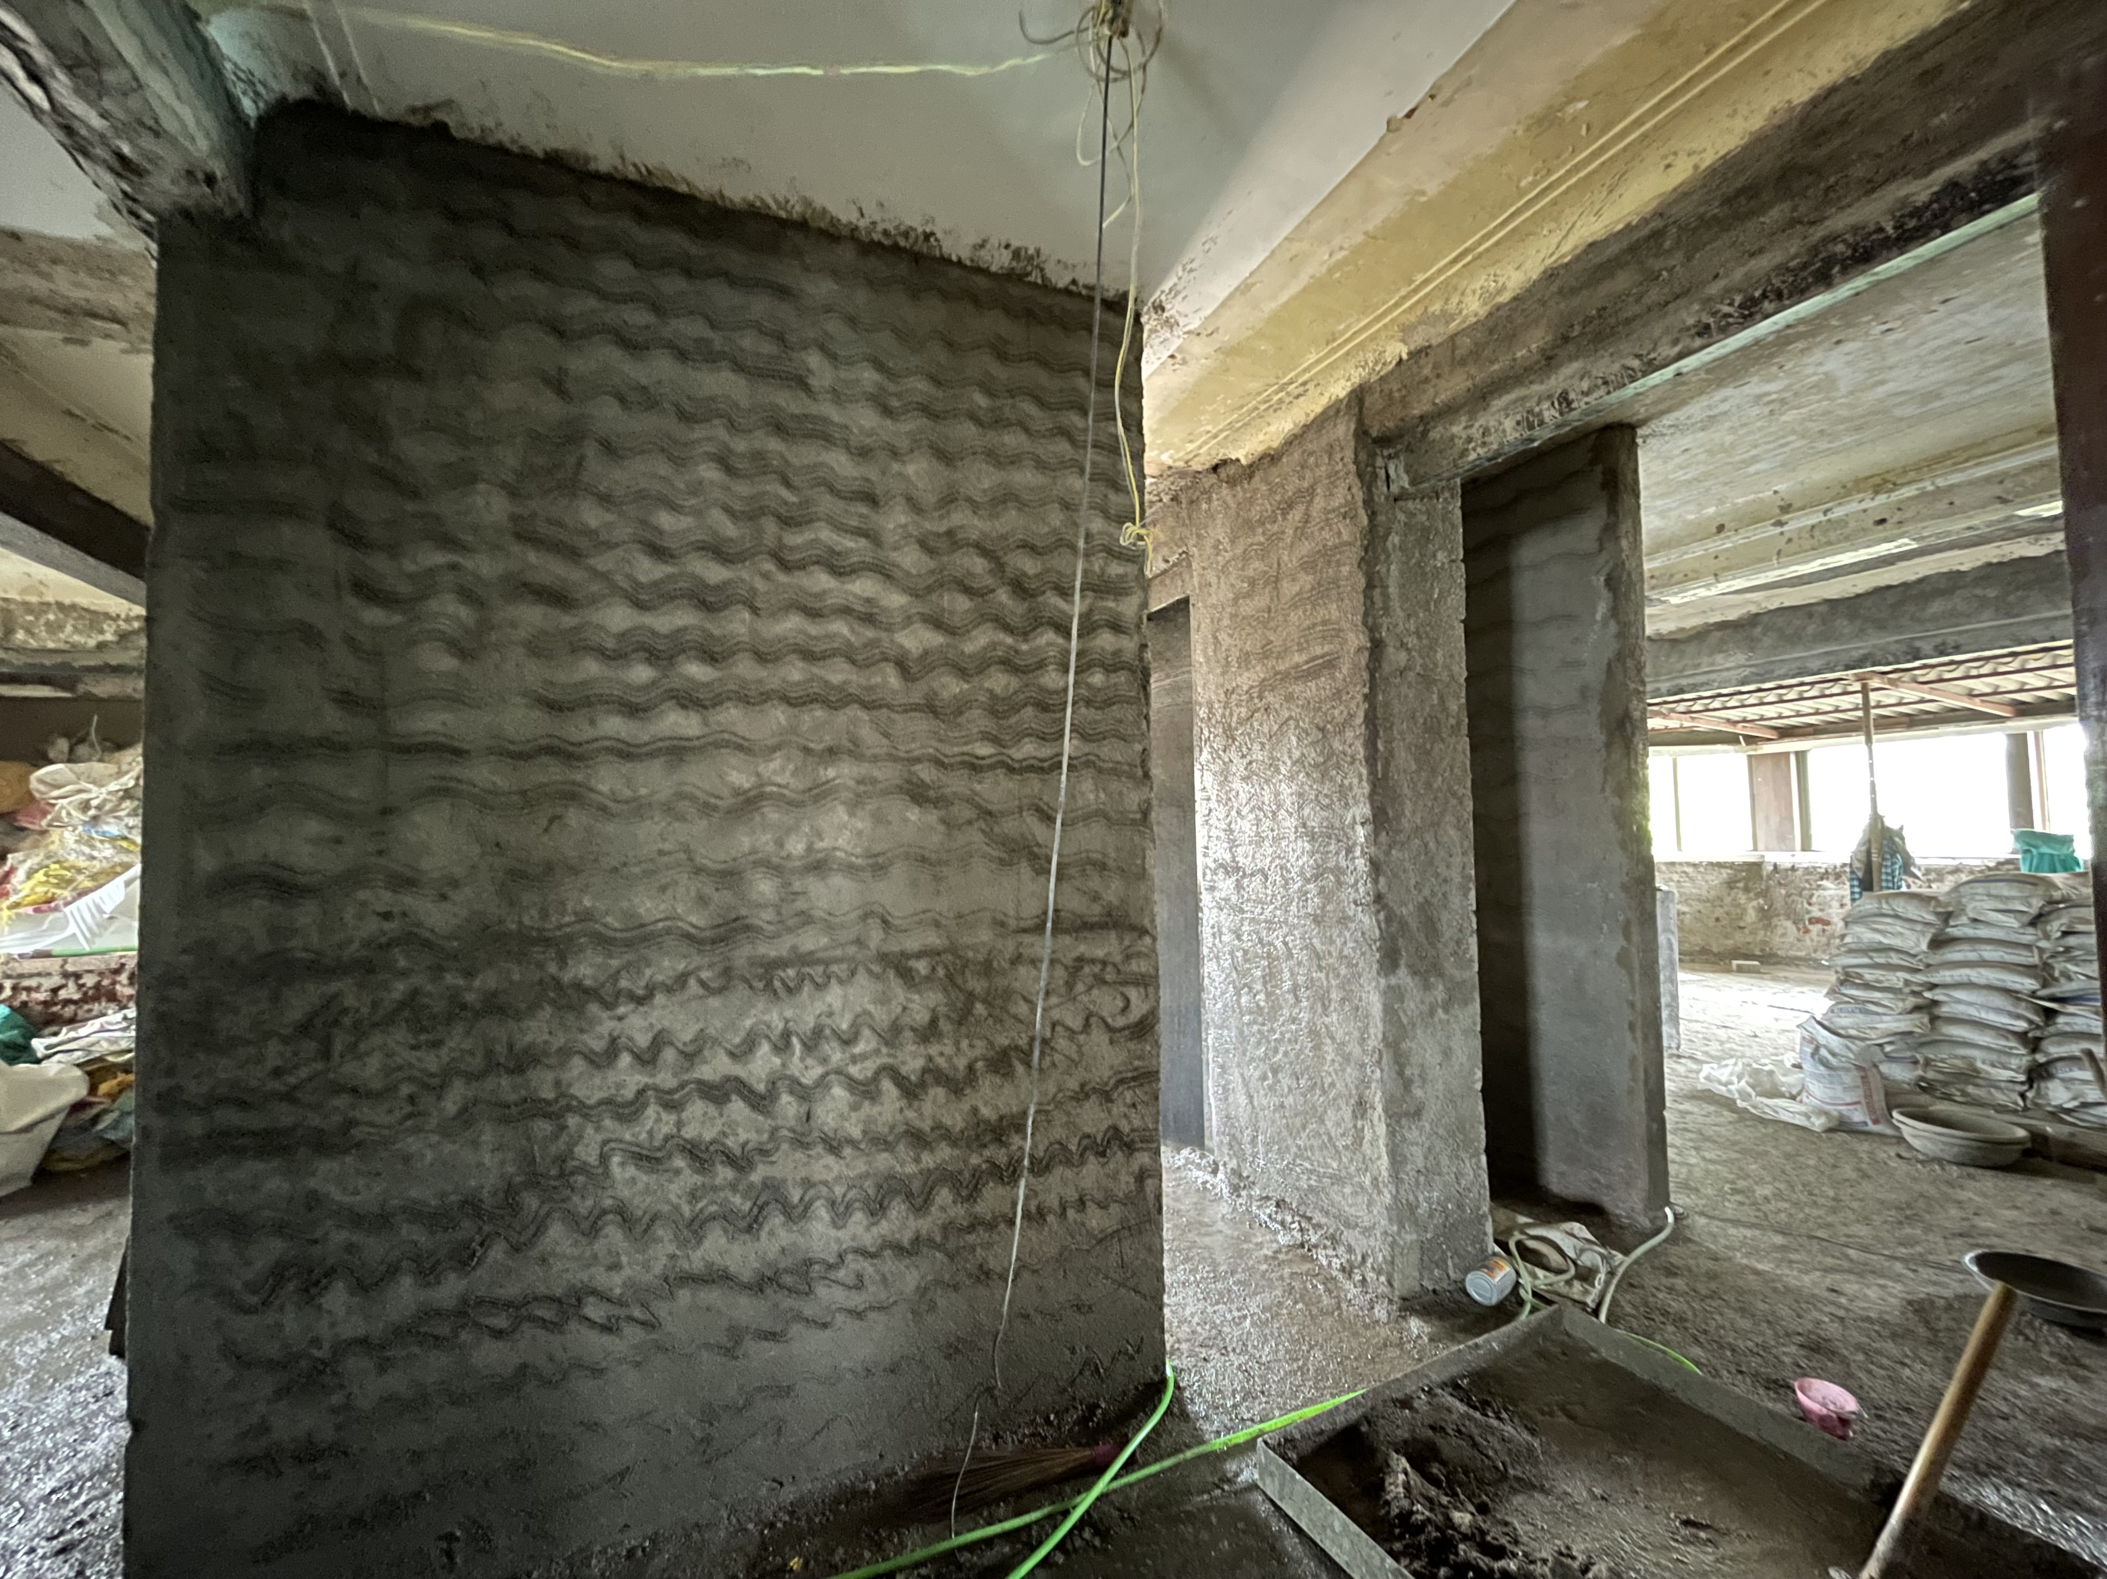
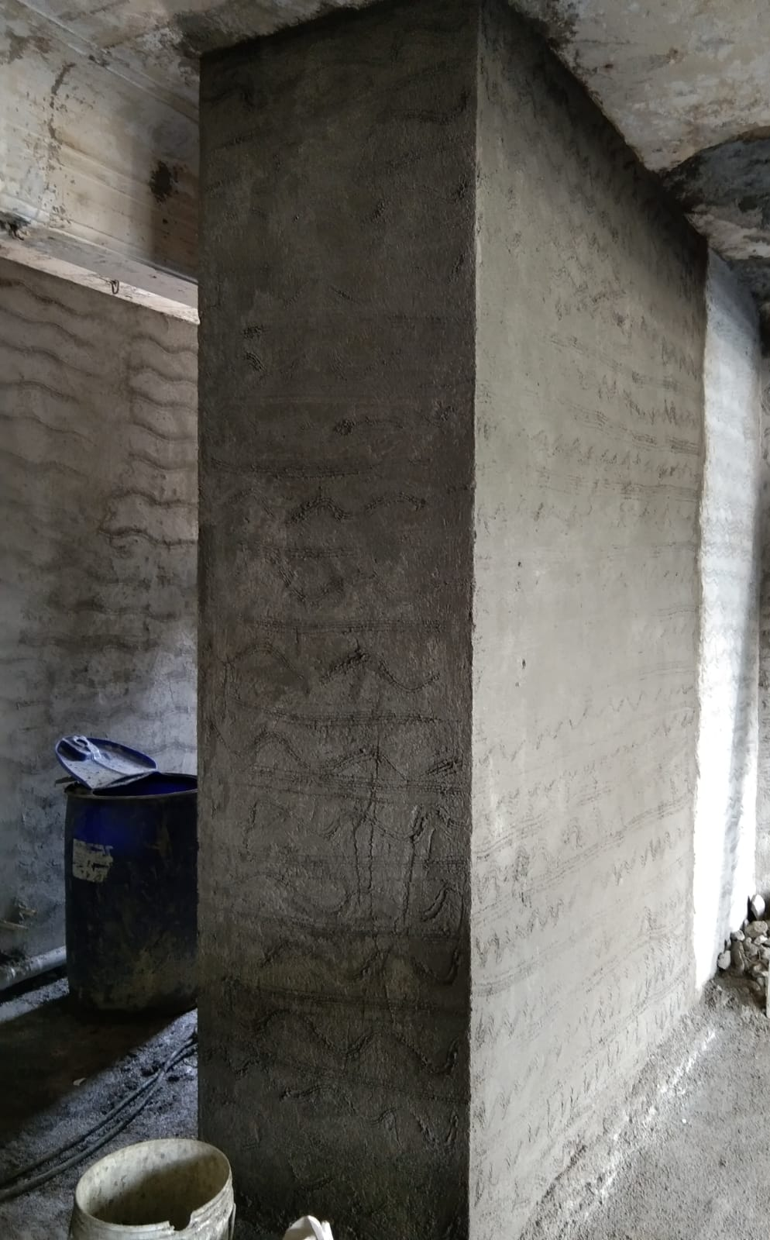
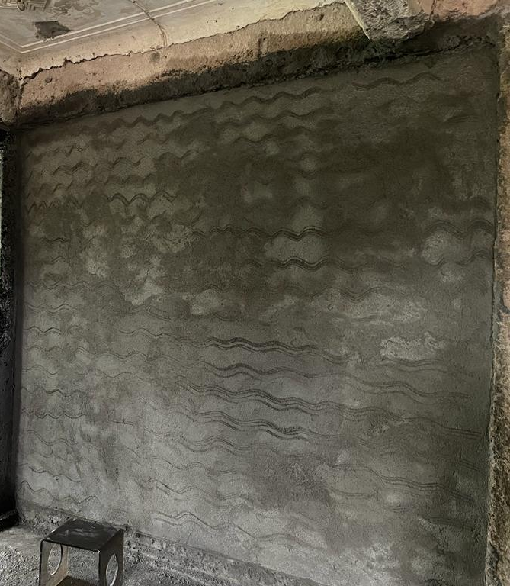
PLASTERING WORK

Slide 12
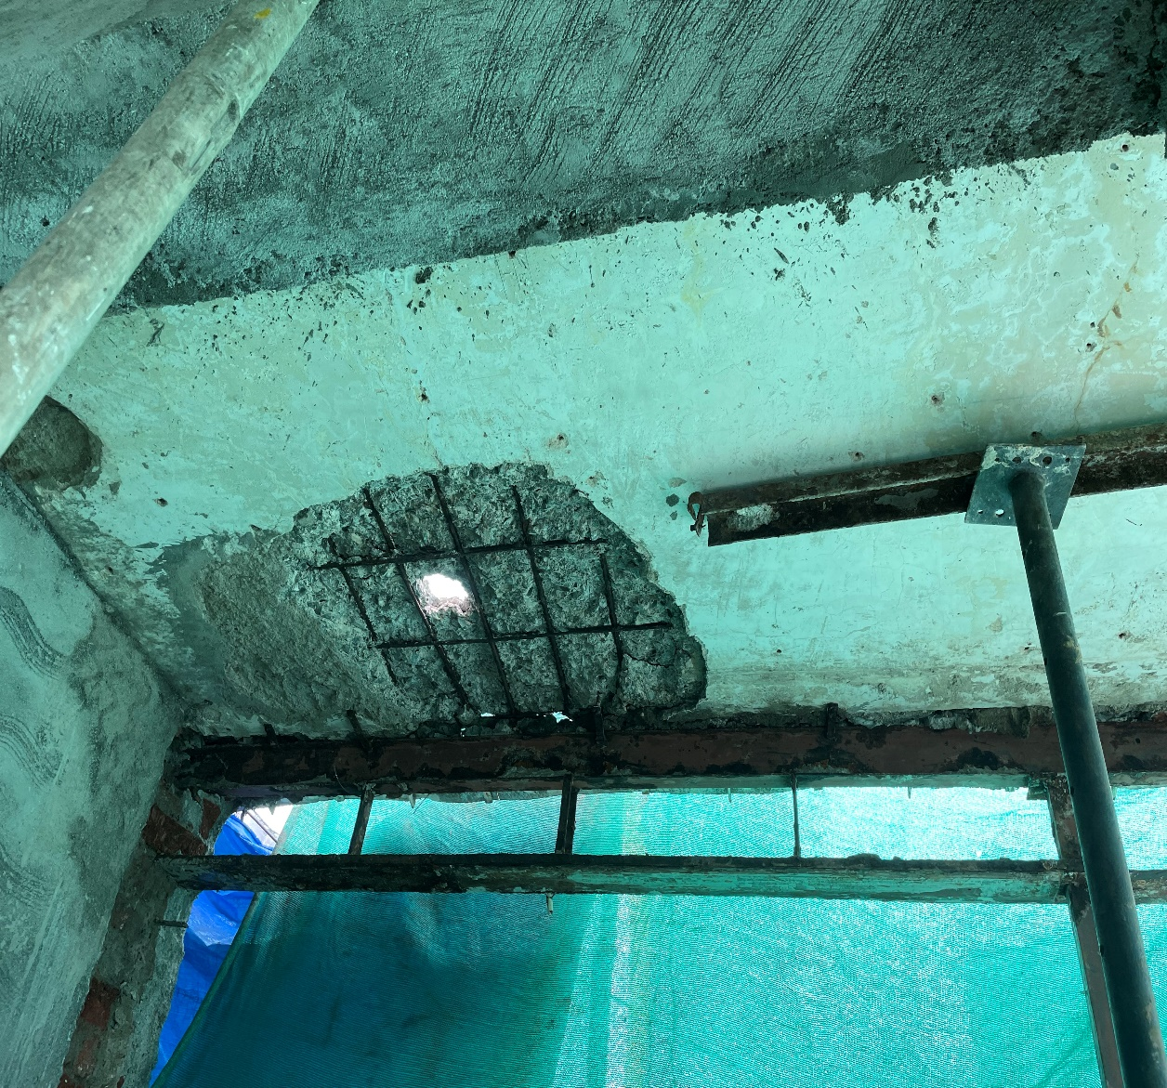
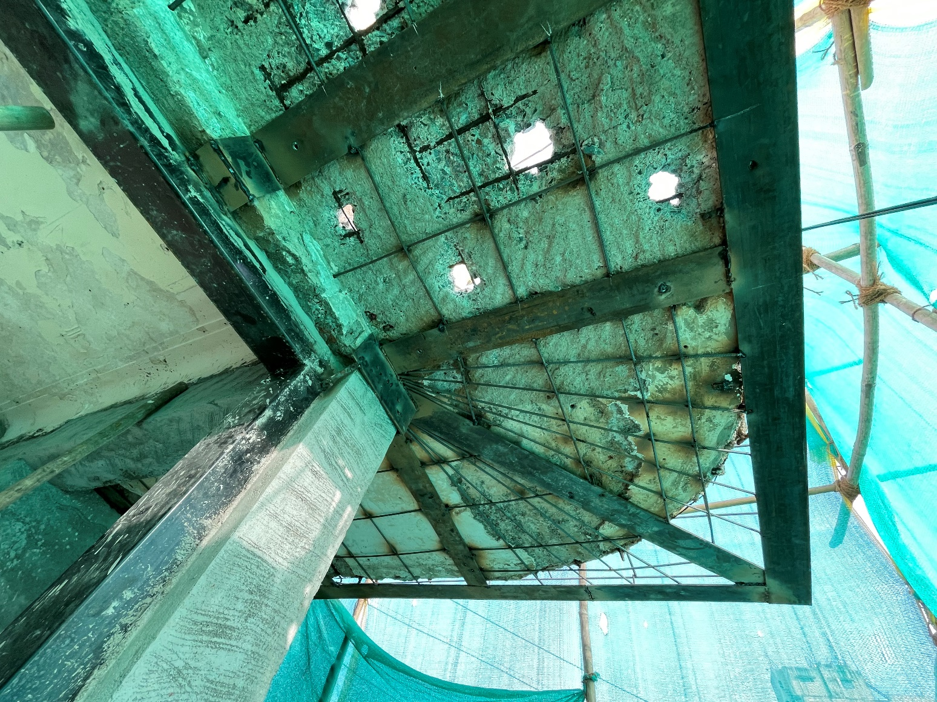
STRENGTHENING OF CHAJJA/SLAB

Slide 13
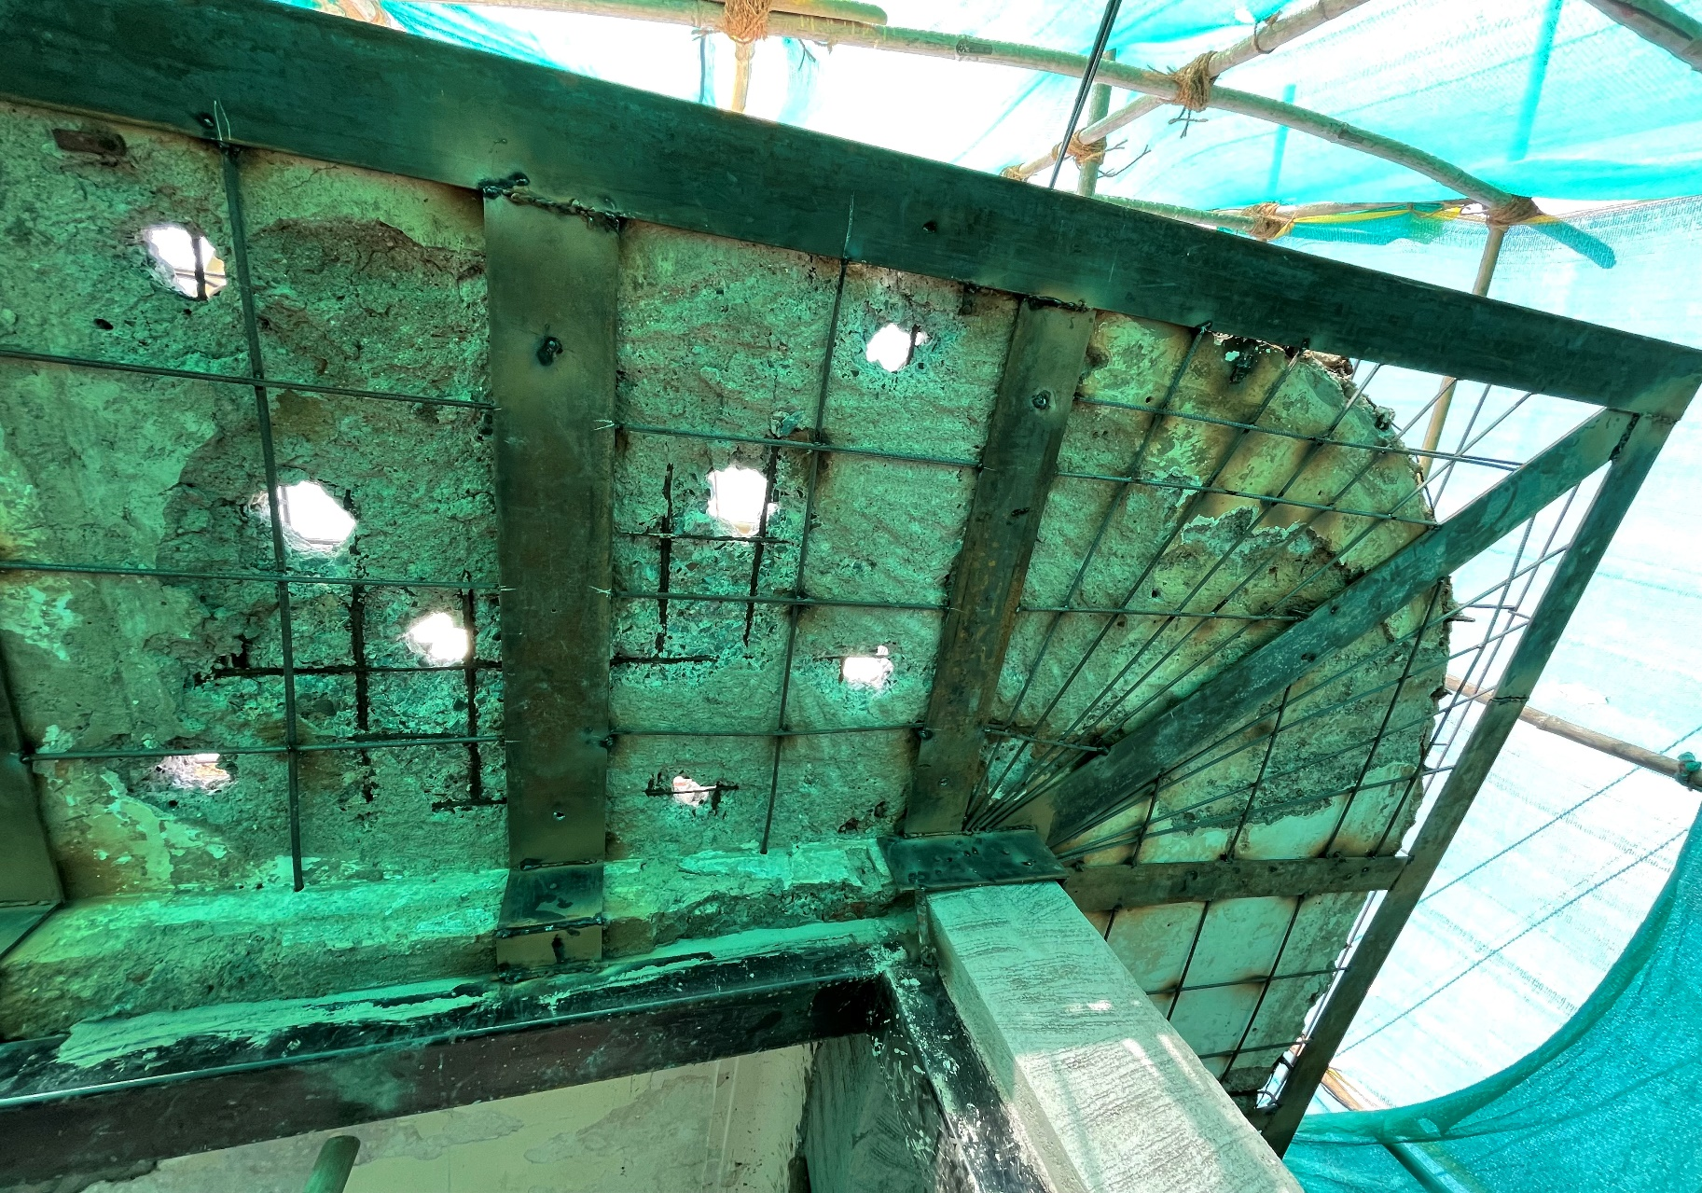
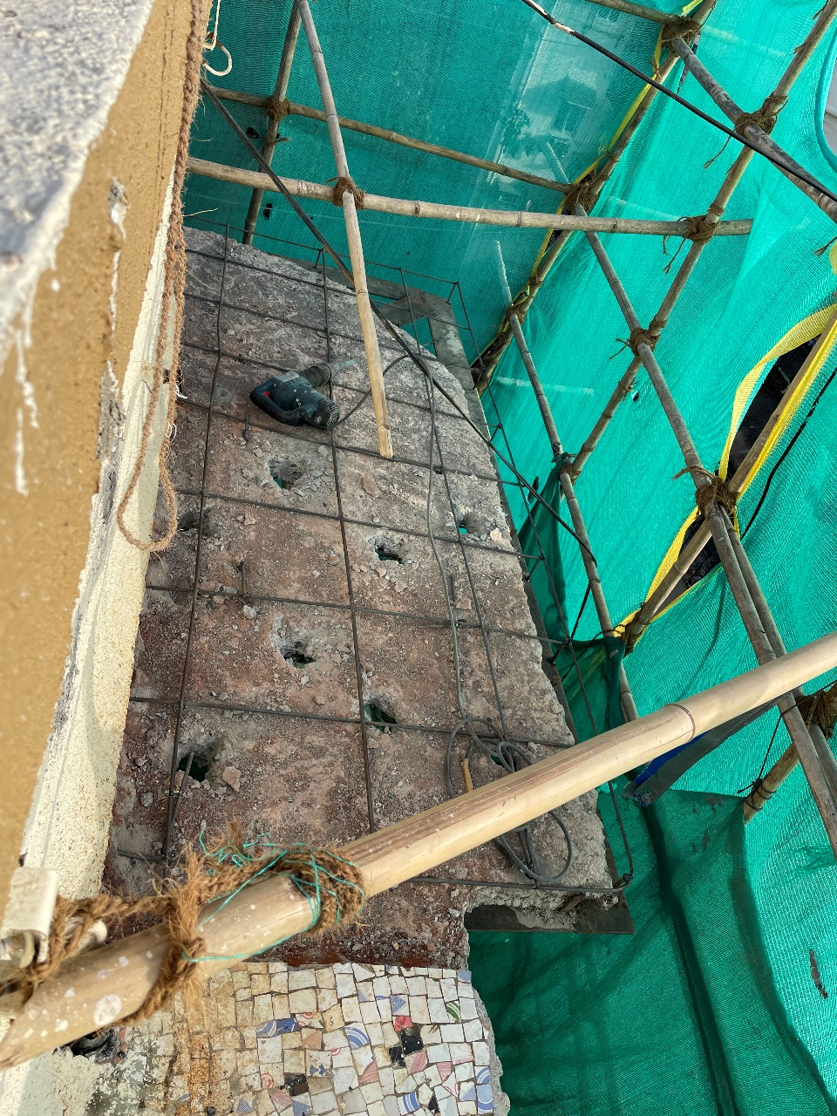
STRENGTHENING OF CHAJJA/SLAB

